Slide 1
Learning Objective
I will be able to determine equations of cubic polynomials
Success Criteria
At the end of the lesson, I will be able to:
Use key features of cubic graphs to determine cubic equations

Slide 2
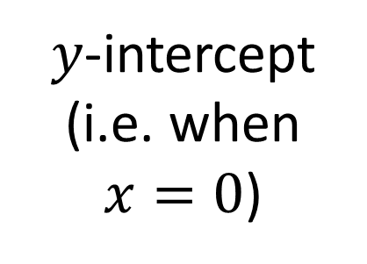
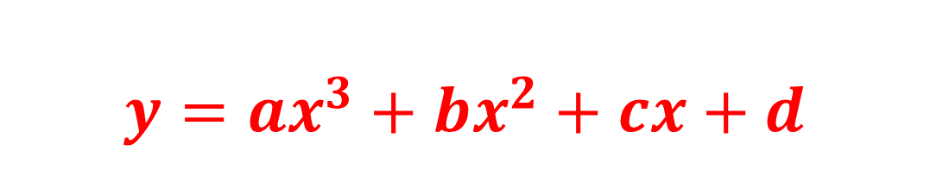
General form of a cubic
Concept Development
$$y={ax}^{3}+bx^{2}+cx+d$$
Leading coefficient
$y$-intercept (i.e. when $x=0$)

Slide 3
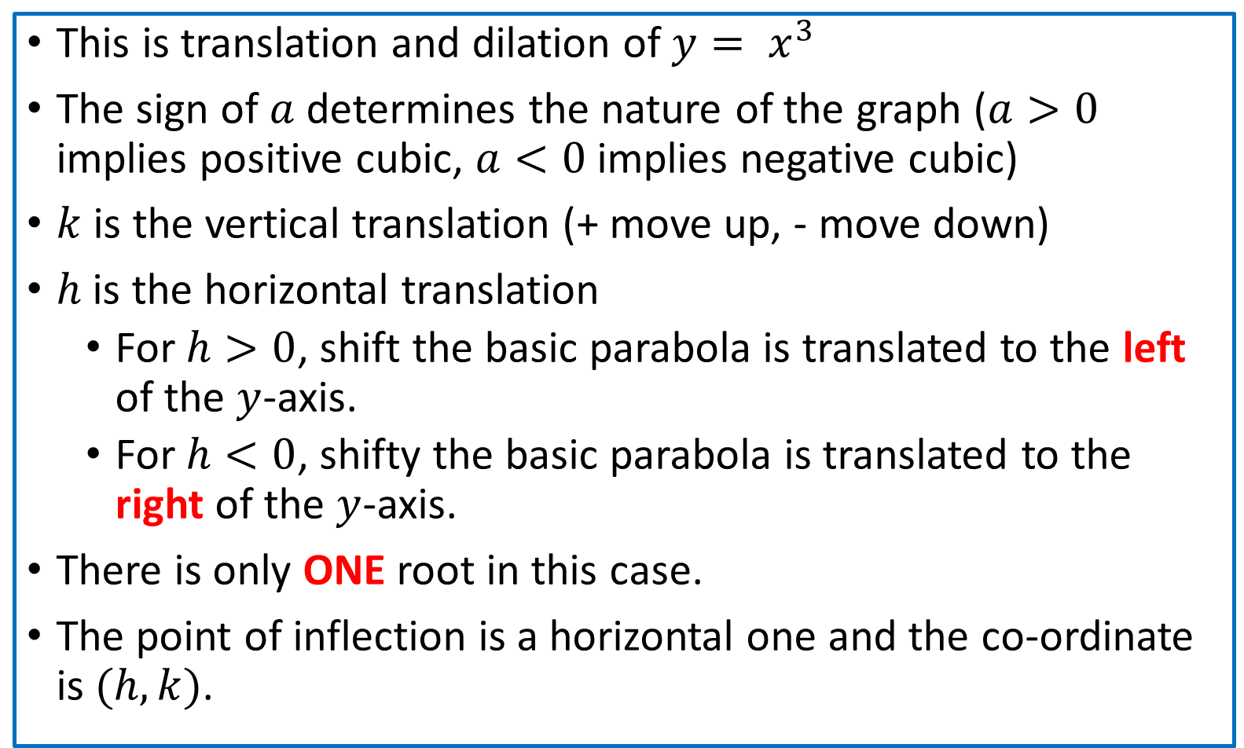

Concept Development
$$y=a{(x−h)}^{3}+k$$
This is translation and dilation of $y= x^{3}$
The sign of $a$ determines the nature of the graph ($a>0$ implies positive cubic, $a<0$ implies negative cubic)
$k$ is the vertical translation (+ move up, - move down)
$h$ is the horizontal translation
For $h>0$, shift the basic parabola is translated to the left of the $y$-axis.
For $h<0$, shifty the basic parabola is translated to the right of the $y$-axis.
There is only ONE root in this case.
The point of inflection is a horizontal one and the co-ordinate is $(h, k)$.

Slide 4

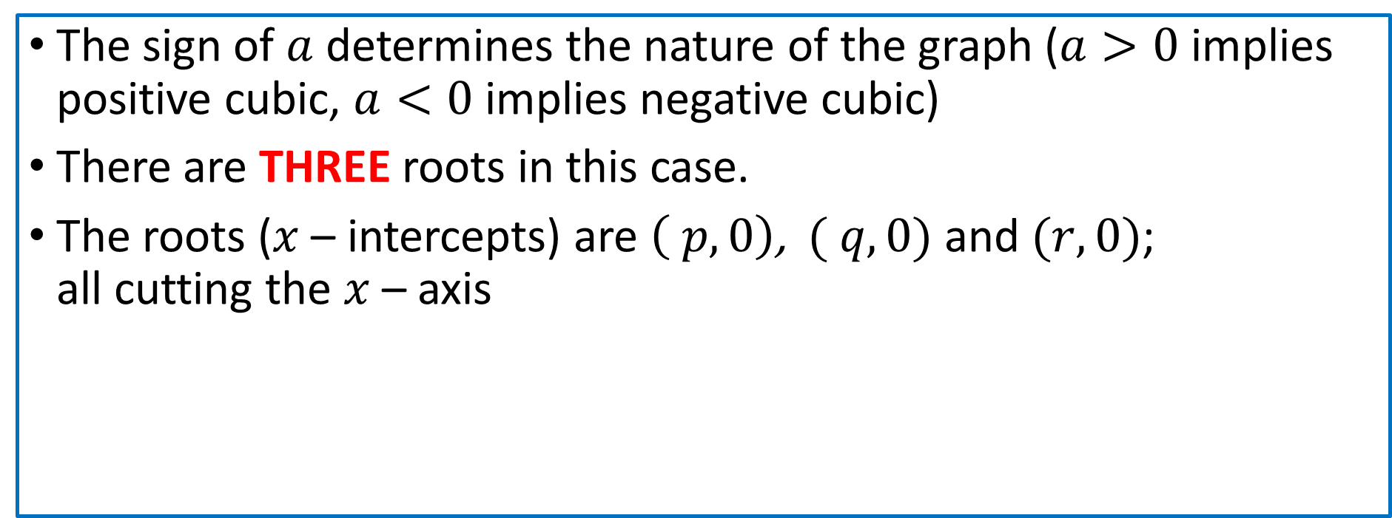

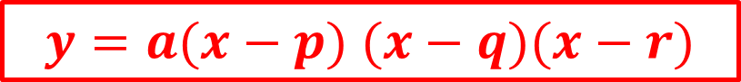




Concept Development
$$y=a(x−p) (x−q)(x−r)$$
The sign of $a$ determines the nature of the graph ($a>0$ implies positive cubic, $a<0$ implies negative cubic)
There are THREE roots in this case.
The roots ($x$ – intercepts) are $\left( p,0\right)$, $( q,0)$ and $(r,0)$; all cutting the $x$ – axis

Slide 5
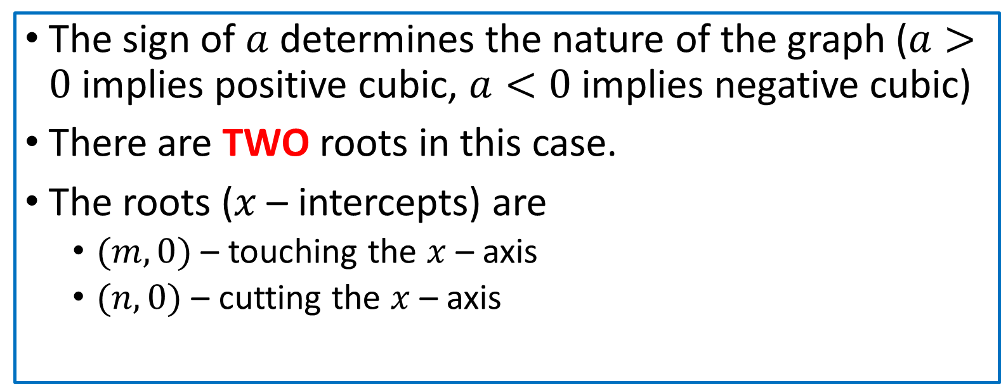



Concept Development
$$y=a{\left(x−m\right)}^{2}(x−n)$$
The sign of $a$ determines the nature of the graph ($a>0$ implies positive cubic, $a<0$ implies negative cubic)
There are TWO roots in this case.
The roots ($x$ – intercepts) are
$(m,0)$ – touching the $x$ – axis
$(n,0)$ – cutting the $x$ – axis

Slide 6
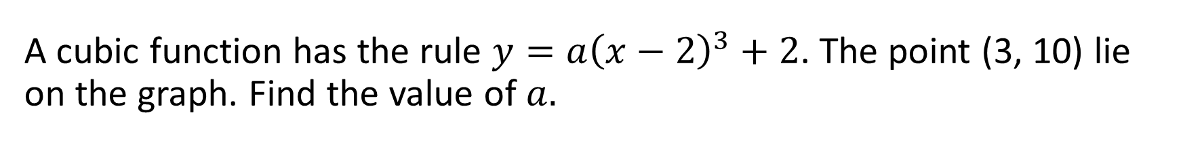
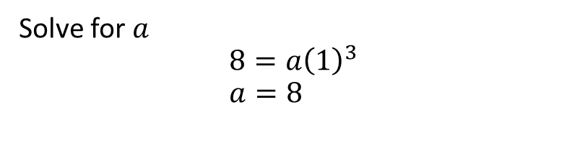
A cubic function has the rule $y={a\left(x−2\right)}^{3}+2$. The point (3, 10) lie on the graph. Find the value of $a.$
Guided Practice
Substitute x = 3, y= 10 into equation,
$$10=a{\left(3−2\right)}^{3}+2$$
Solve for $a$
$$8=a{\left(1\right)}^{3} \\ a=8$$

Slide 7
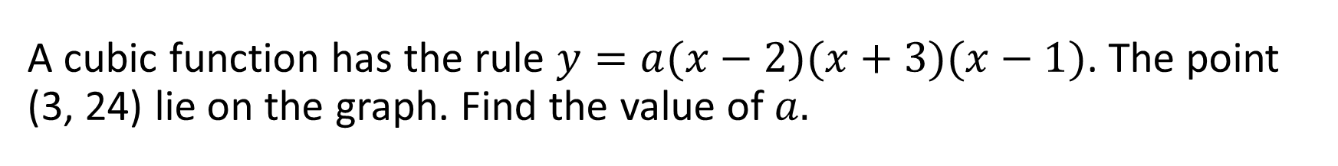
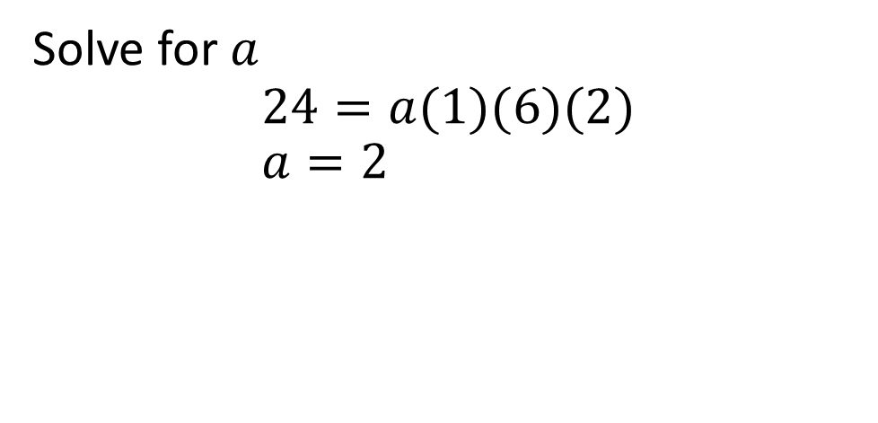
A cubic function has the rule $y=a(x−2)(x+3)(x−1)$. The point (3, 24) lie on the graph. Find the value of $a.$
Guided Practice
Substitute x = 3, y= 24 into equation,
$$24=a(3−2)(3+3)(3−1)$$
Solve for $a$
$$24=a(1)(6)(2) \\ a=2$$

Slide 8
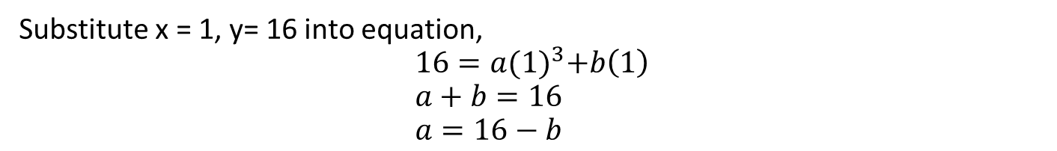
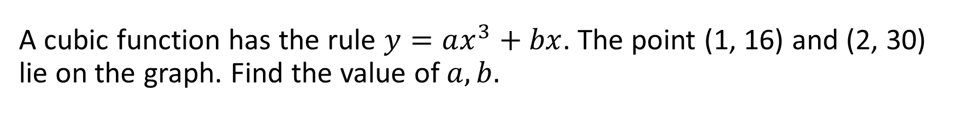
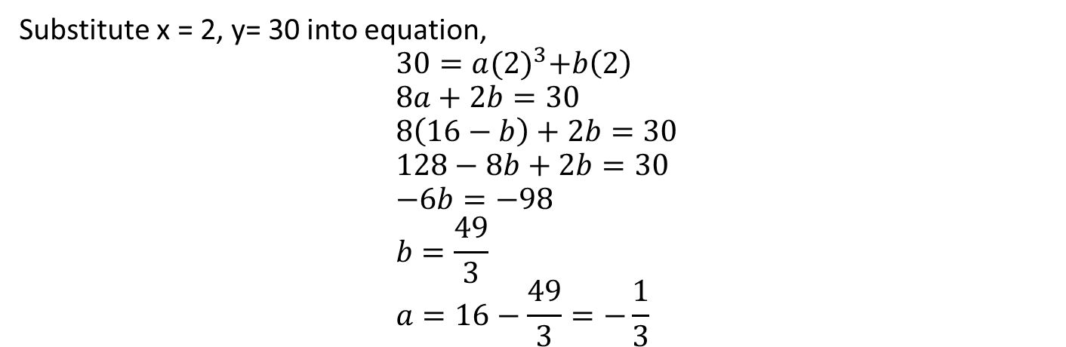
A cubic function has the rule $y=ax^{3}+bx$. The point (1, 16) and (2, 30) lie on the graph. Find the value of $a, b.$
Guided Practice
Substitute x = 1, y= 16 into equation,
$$16=a{(1)}^{3}+b\left(1\right) \\ a+b=16 \\ a=16−b$$
Substitute x = 2, y= 30 into equation,
$$30=a{(2)}^{3}+b\left(2\right) \\ 8a+2b=30 \\ 8\left(16−b\right)+2b=30 \\ 128−8b+2b=30 \\ −6b=−98 \\ b=\frac{49}{3} \\ a=16−\frac{49}{3}=−\frac{1}{3}$$

Slide 9
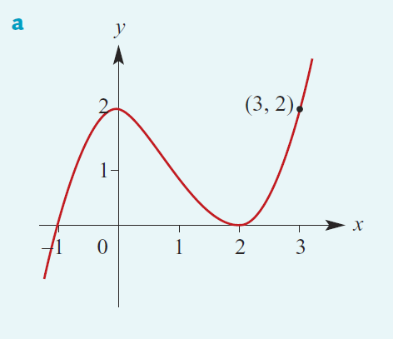
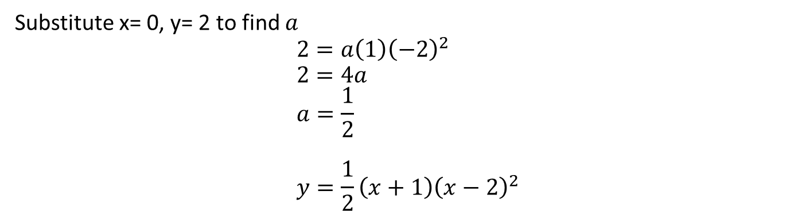
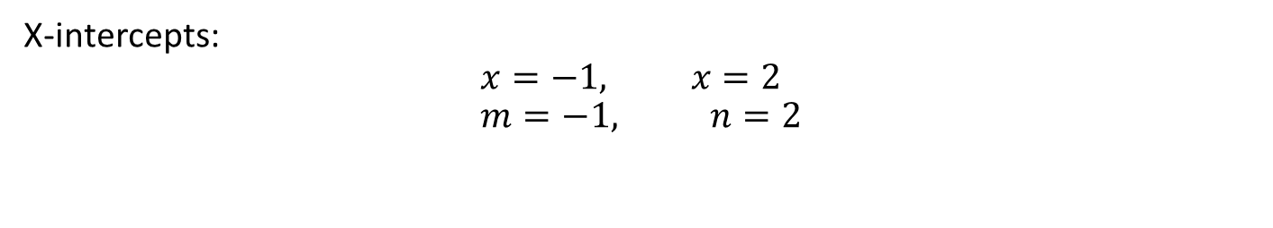
Determine the rule of the graph.
Guided Practice
Two roots, so use the form:
$$y=a\left(x−m\right){\left(x−n\right)}^{2}$$
X-intercepts:
$$x=−1, x=2 \\ m=−1, n=2$$
$$y=a\left(x+1\right){\left(x−2\right)}^{2}$$
Substitute x= 0, y= 2 to find $a$ $$2=a\left(1\right){\left(−2\right)}^{2} \\ 2=4a \\ a=\frac{1}{2} \\ y=\frac{1}{2}\left(x+1\right){\left(x−2\right)}^{2}$$

Slide 10
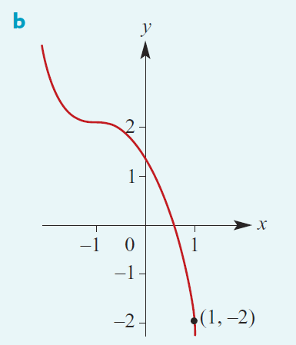
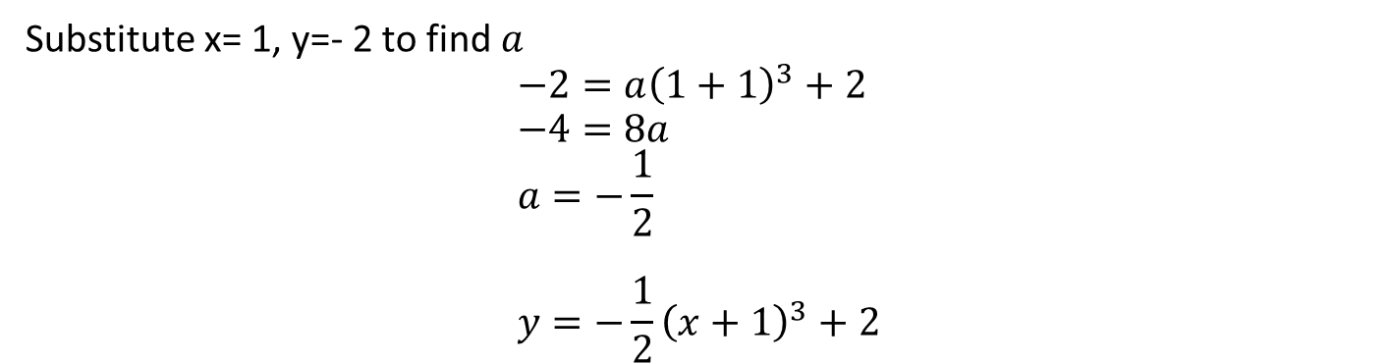
Determine the rule of the graph.
Guided Practice
One roots, so use the form:
$$y=a{\left(x−h\right)}^{3}+k$$
Point of inflection: (-1, 2)
$$h=−1, k=2$$
$$y=a{\left(x+1\right)}^{3}+2$$
Substitute x= 1, y=- 2 to find $a$ $$−2=a{\left(1+1\right)}^{3}+2 \\ −4=8a \\ a=−\frac{1}{2} \\ y=−\frac{1}{2}{\left(x+1\right)}^{3}+2$$

Slide 11
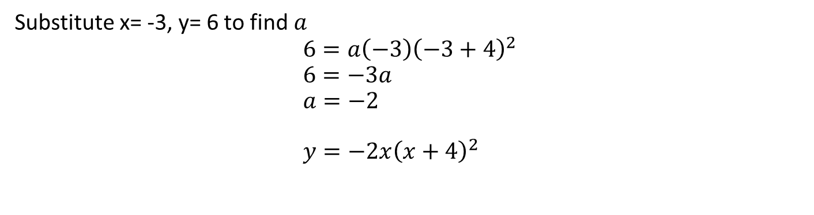
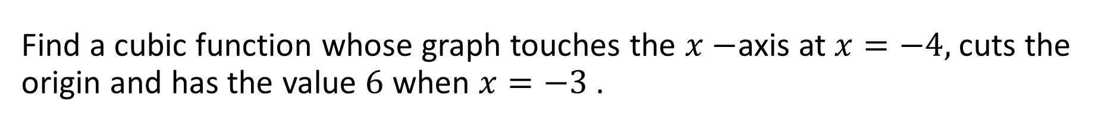

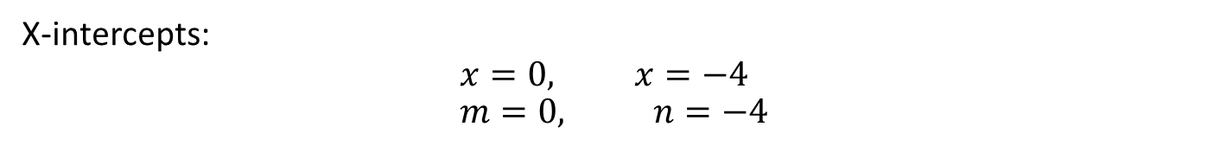

Find a cubic function whose graph touches the $x−$axis at $x=−4,$ cuts the origin and has the value $6$ when $x=−3$.
Cambridge Ex 7G Q4
Two roots, so use the form:
$$y=a\left(x−m\right){\left(x−n\right)}^{2}$$
X-intercepts:
$$x=0, x=−4 \\ m=0, n=−4$$
$$y=ax{\left(x+4\right)}^{2}$$
Substitute x= -3, y= 6 to find $a$ $$6=a\left(−3\right){\left(−3+4\right)}^{2} \\ 6=−3a \\ a=−2 \\ y=−2x{\left(x+4\right)}^{2}$$

Slide 12
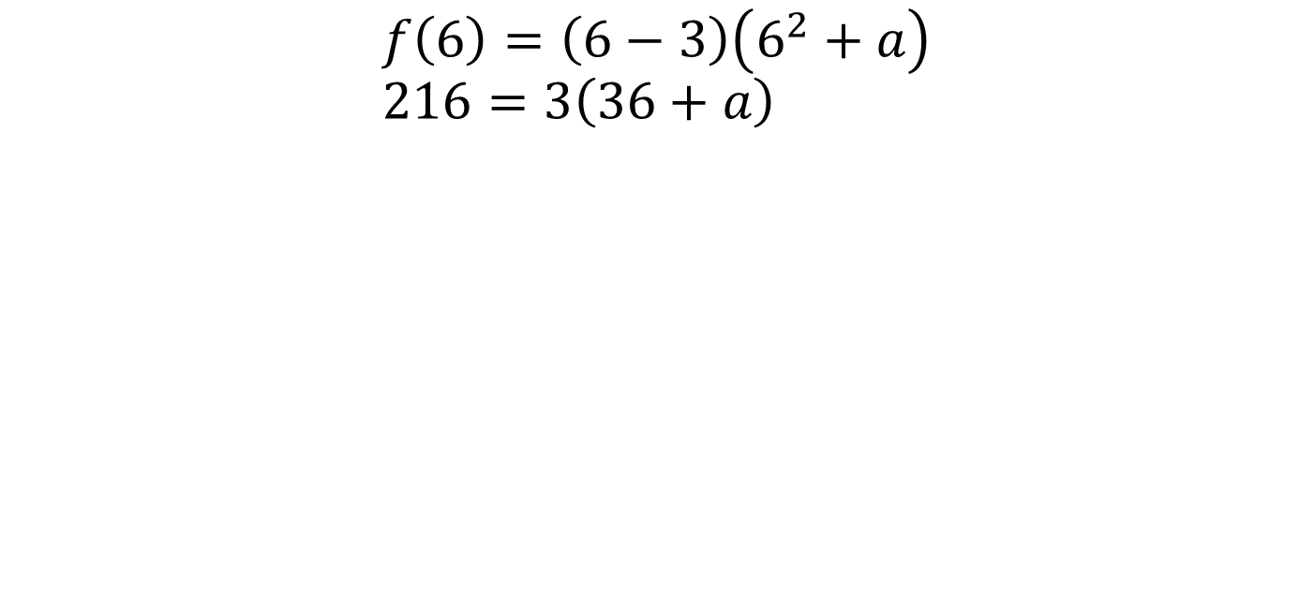
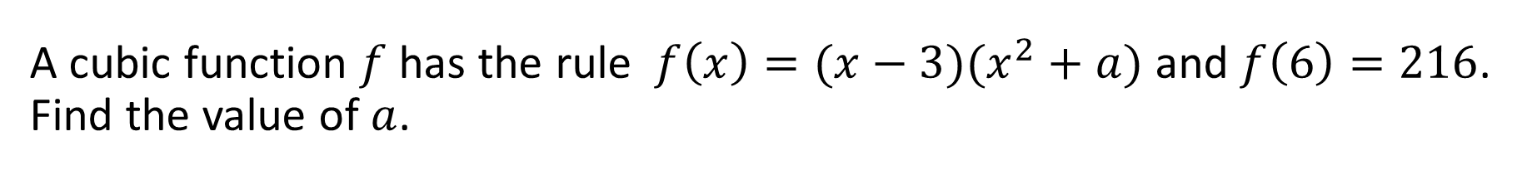
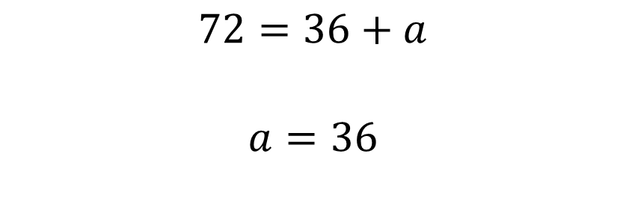
A cubic function $f$ has the rule $f\left(x\right)=(x−3)(x^{2}+a)$ and $f\left(6\right)=216$. Find the value of $a$.
Cambridge Ex 7G Q6
$$f\left(6\right)=\left(6−3\right)\left(6^{2}+a\right) \\ 216=3\left(36+a\right)$$
$$72=36+a$$ $$a=36$$

Slide 13
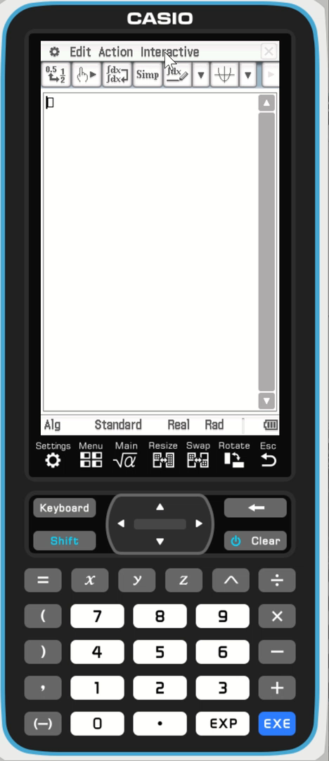




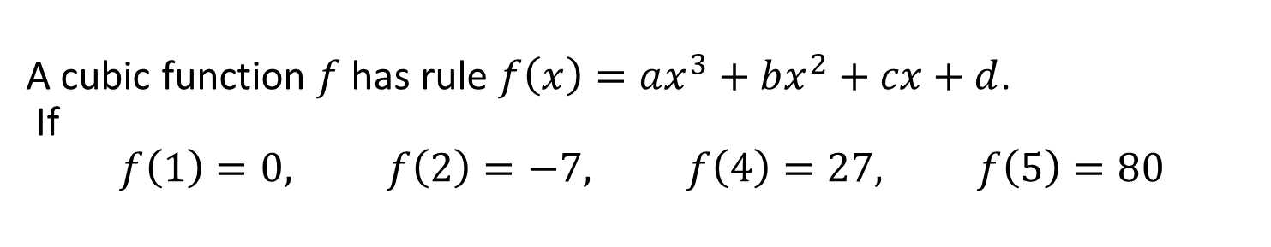
A cubic function $f$ has rule $f\left(x\right)=ax^{3}+bx^{2}+cx+d$. If $$f\left(1\right)=0, f\left(2\right)=−7, f\left(4\right)=27, f\left(5\right)=80$$
Guided Practice

Slide 14
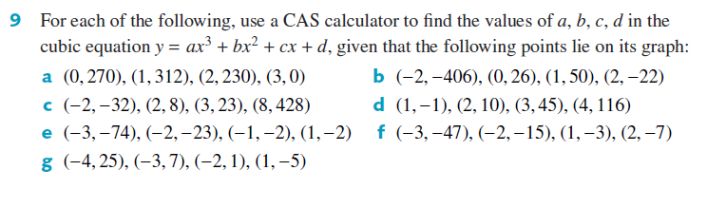
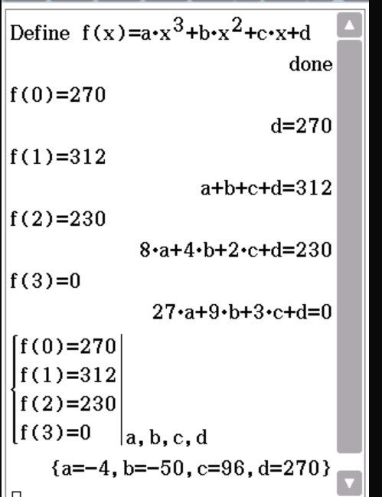
Guided Practice

Slide 15
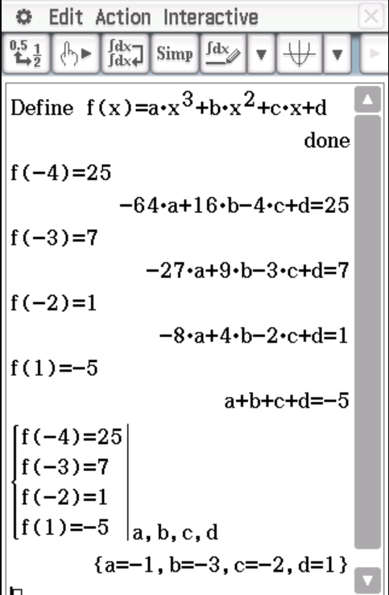


Guided Practice

Slide 16
Independent Practice
Complete Ex 7G

